Slide 1
Hashing Data Structure

Slide 2
Hashing
Hashing is a technique or process of mapping keys, values into the hash table by using a hash function. It is done for faster access to elements. The efficiency of mapping depends on the efficiency of the hash function used.
Let a hash function H(x) maps the value at the index x%10 in an Array.
For example if the list of values is [11,12,13,14,15] it will be stored at positions {1,2,3,4,5} in the array or Hash table respectively.

Slide 3
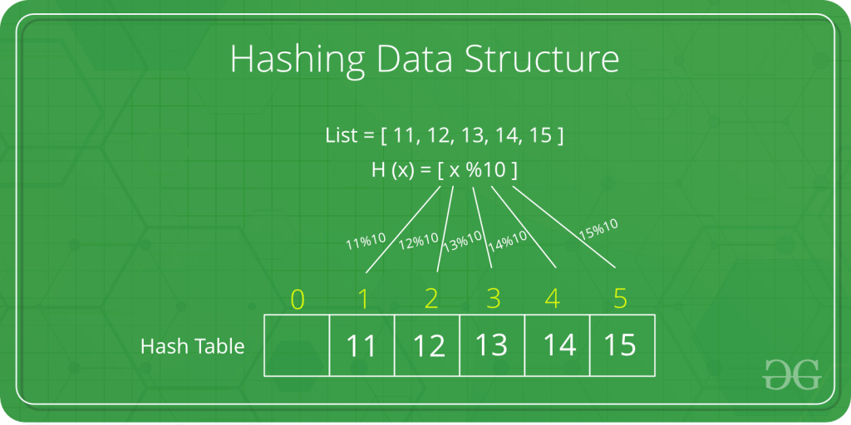

Slide 4
Key Pair
Given an array Arr of N positive integers and another number X. Determine whether or not there exist two elements in Arr whose sum is exactly X.
Example 1:
Input: N = 6, X = 16 Arr[] = {1, 4, 45, 6, 10, 8}
Output: Yes
Explanation: Arr[3] + Arr[4] = 6 + 10 = 16
Example 2:
Input: N = 5, X = 10 Arr[] = {1, 2, 4, 3, 6} Output: Yes

Slide 5
Hashing
Recursion and Backtracking
DnC -> quick sort, merge sort, binary search
Greedy
Tree
Graph
Dynamic Program

Slide 6
Length of the longest subarray with zero Sum
Problem Statement: Given an array containing both positive and negative integers, we have to find the length of the longest subarray with the sum of all elements equal to zero.
Example 1:
Input Format: N = 6, array[] = {9, -3, 3, -1, 6, -5}
Result: 5
Example 2:
Input Format: N = 8, array[] = {6, -2, 2, -8, 1, 7, 4, -10}
Result: 8 Subarrays with sum 0 : {-2, 2}, {-8, 1, 7}, {-2, 2, -8, 1, 7}, {6, -2, 2, -8, 1, 7, 4, -10} Length of longest subarray = 8
Example 3:
Input Format: N = 3, array[] = {1, 0, -5} Result: 1 Subarray : {0} Length of longest subarray = 1

Slide 7
Two Sum : Check if a pair with given sum exists in Array
Problem Statement: Given an array of integers nums[] and an integer target, return indices of the two numbers such that their sum is equal to the target.
Note: Assume that there is exactly one solution, and you are not allowed to use the same element twice. Example: If target is equal to 6 and num[1] = 3, then nums[1] + nums[1] = target is not a solution.
Example 1:
Input: nums = [2,7,11,15], target = 9 Output: [0,1] Explanation: Because nums[0] + nums[1] == 9, which is the required target, we return indexes [0,1]. (0-based indexing)
Example 2:
Input Format: nums = [3,2,4,6], target = 6 Output: [1,2] Explanation: Because nums[1] + nums[2] == 6, which is the required target, we return indexes [1,2].

Slide 8
4 Sum | Find Quads that add up to a target value
Problem Statement: Given an array of N integers, your task is to find unique quads that add up to give a target value. In short, you need to return an array of all the unique quadruplets [arr[a], arr[b], arr[c], arr[d]] such that their sum is equal to a given target. Pre-req: Binary Search and 2-sum problem
Note:
0 <= a, b, c, d < n
a, b, c, and d are distinct.
arr[a] + arr[b] + arr[c] + arr[d] == target
Example 1:
Input Format: arr[] = [1,0,-1,0,-2,2], target = 0 Result: [[-2,-1,1,2],[-2,0,0,2],[-1,0,0,1]] Explanation: We have to find unique quadruplets from the array such that the sum of those elements is equal to the target sum given that is 0. The result obtained is such that the sum of the quadruplets yields 0.
Example 2:
Input Format: arr[] = [4,3,3,4,4,2,1,2,1,1], target = 9 Result: [[1,1,3,4],[1,2,2,4],[1,2,3,3]]

Slide 9
Longest Consecutive Sequence in an Array
Problem Statement: You are given an array of ‘N’ integers. You need to find the length of the longest sequence which contains the consecutive elements.
Examples:
Example 1: Input: [100, 200, 1, 3, 2, 4] Output: 4
Explanation: The longest consecutive subsequence is 1, 2, 3, and 4.
Input: [3, 8, 5, 7, 6] Output: 4
Explanation: The longest consecutive subsequence is 5, 6, 7, and 8.

Slide 10
Length of Longest Substring without any Repeating Character
Problem Statement: Given a String, find the length of longest substring without any repeating character.
Examples:
Example 1:
Input: s = ”abcabcbb”
Output: 3
Explanation: The answer is abc with length of 3.
Example 2:
Input: s = ”bbbbb”
Output: 1 Explanation: The answer is b with length of 1 units.

